Slide 1
Fitting Gaussian curves on data points
The Maximum Likelihood and the Bayesian approach

Slide 2
Where did we stop?
The Bayes decision rule guarantees an optimal classification…
… But it requires the knowledge of P(c_{i}|x) (or p(x|c_{i}) and P(c_{i}))
We assumed that p(x|c_{i}) is Gaussian for all classes
  And we examined how the decision surfaces look like for given parameters Σ_{i} and μ_{i}
We will still assume that the distribution is Gaussian
  But now we will learn how to estimate the parameters from the data

Slide 3
Parameter estimation for Gaussians
We want to estimate p(x|c_{i}) and P(c_{i}) from data samples
The class priors from a discrete distribution, it can be easily estimated from the data by simple counting
  E.g. we have 2 classes, 60 examples from class 1 and 40 from class 2
  Then we can estimates P(c₁)≈60/(60+40), P(c₂)≈40/(60+40)
If the features are continuous, then p(x|c_{i}) is a multivariate continuous distribution, much more difficult to estimate
We will assume that p(x|c_{i}) is Gaussian
  As a Gaussian is defined by Σ_{i} and μ_{i} , we will have to estimate these parameters from the data
  We will do this for each class separately, independent of the other classes
    We will temporarily drop index i from the formulas

Slide 4
Parameter estimation approaches
We will examine two approaches for estimating the parameters
  Maximum likelihood approach: simpler, more frequently used in practice
  Bayes approach: theoretically more involved, less frequently used in practice
  Fortunately, they will give very similar results even though their theoretical background is different
No matter which approach we use for parameter estimation, during classification we apply the result the same way
  Remember the Bayes decision (calculate the likelihood of all classes, then select the most likely one)

Slide 5
Parameter estimation approaches - Comparison
Maximum likelihood approach
  It assumes that the parameters Σ and μ have concrete values, but they are unknown to us
  It will select those parameter values that give the best explanation (assign the highest likelihood value) to the data
Bayesian approach
  It treats the parameters not as numbers with missing values, but as stochastic variables that also have a probability distribution
    First will try to model their probability distribution, and we will select a concrete value from this distribution only in the end
  We will first assume a prior distribution for the parameters, and then refine this model based on the observed data

Slide 6
Maximum Likelihood estimation
This is the simplest possible solution
If the data indeed has a Gaussian distribution, then is quickly converges to the real parameter values when the amount of training data is increases
We will assume that the data in each class has a Gaussian distribution, and we will estimate these separately for each class
We will shortly notate the parameters as θ=(μ_{i} , Σ_{i} )
The training data set will be shortly denoted by D
  D={x₁,…,x_{n}}
  We assume that the data samples are independent and identically distributed (shortly “i.i.d.”)

Slide 7
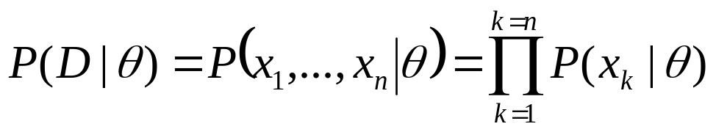
The “Likelihood” target function
We will seek to maximize the likelihood
The maximum likelihood estimate of θ will be that value that maximizes P(D | θ)
  Explanation #1: this is the θ value by which the likelihood curve gives the best explanation for the data
  Explanation #2: Consider that when applying the Bayes decision rule, we will select the class for which the likelihood curve gives the largest value. So during training, to increase the chance of correct classification, we seek to achieve the largest possible likelihood value for the samples that belong to the given class

Slide 8
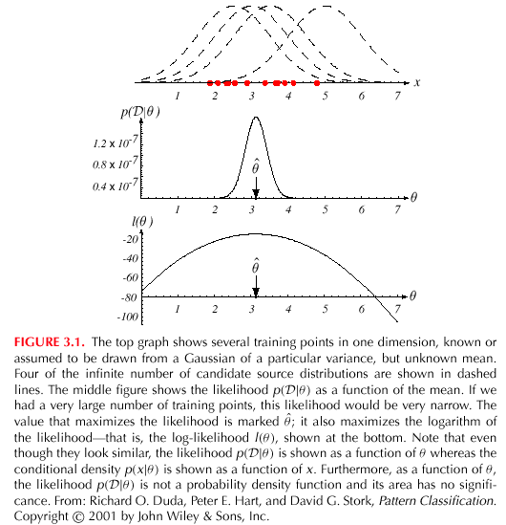
The “Log-likelihood” target function
Just as earlier, we will use the logarithmized version of the target function – its takes its optimum at the same point, but easier to handle
Example: 1D Gaussian, σ² is known, we seek the optimal value for μ
  The training points and
  four candidates
  The likelihood function
  (as a function of θ)
  and its optimum point
  The log-likelihood function and its optimum point

Slide 9


Maximizing the log-likelihood
Just as earlier, we will use the logarithmized version of the target function – its takes its optimum at the same point, but easier to handle
Example: 1D Gaussian,, we seek the optimal value for μ and σ
We want to maximize wrt. θ = (θ₁, θ₂) = (μ, σ²)
Replacing the variables and taking the logarithm, the log-likelihood function becomes

Slide 10
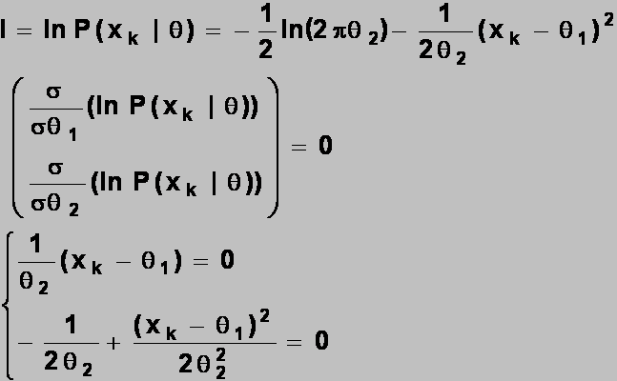
Maximizing the log-likelihood 2
We will maximize the target function by setting its derivatives to zero
with respect to both variables
  We don’t have to examine the second derivatives, as the function is quadratic

Slide 11
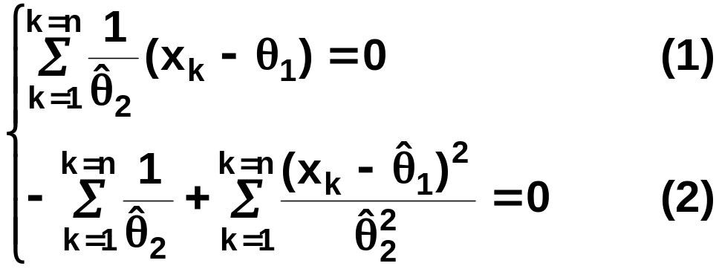
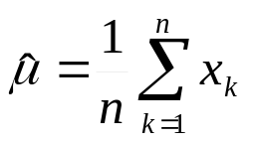
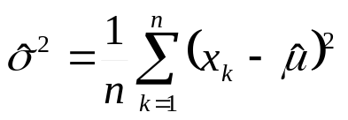
Maximizing the log-likelihood 3
Summing over all the data points, we get
Combining (1) and (2) gives the result that
That is, we estimate μ as the mean of the data points, and σ² as their average distance from μ
  These values as the so-called sufficient statistics for a normal distribution
  This means that we don’t need the original data values, only these too statistics to estimate the their distribution

Slide 12
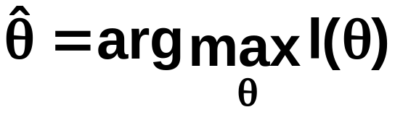
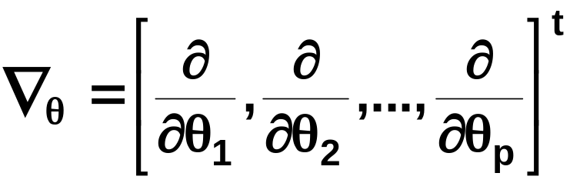
Maximizing the log-likelihood
– Multivariate case
In the general case the features are vectors, so the Gaussian distribution is multivariate
We apply the same method – setting the derivative of the
log-likelihood function to zero – but as the function is multivariate, we need to use the gradient operator instead of the univariate derivative. So we seek to find
And we apply the gradient operator

Slide 13
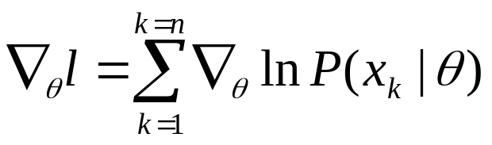
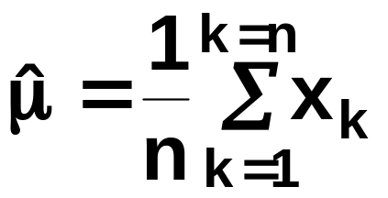
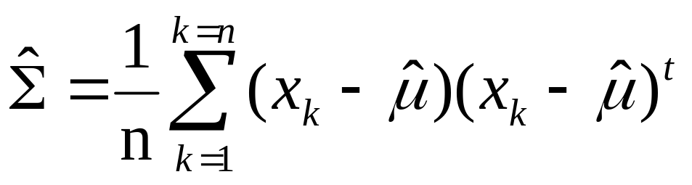
Maximizing the log-likelihood
Applying the gradient operator to the log-likelihood function gives
And we set ∇_{θ}l = 0
The result (without derivation):
Very similar to the univariate case!
  These are just the mean vector and the covariance matrix of the data

Slide 14
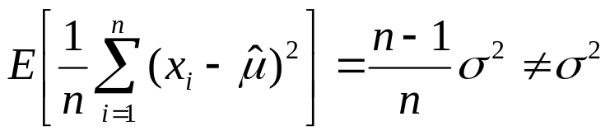
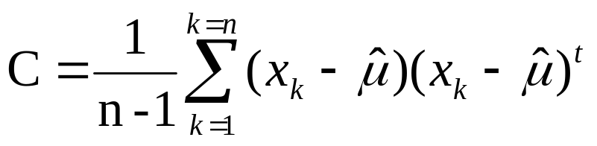
Remark #1
The estimate we obtained for σ² (or Σ) is biased, because
So, in theory, it’s better to use the following estimate (for Σ):
But in practice it doesn’t really matter as n is large, so
1/n ≈1/(n-1)
Non-invertible covariance matrix
Restriction for diagonal

Slide 15
Remark #2
In practice the estimate for Σ may turn out to be non-invertible (remember that the formula requires Σ⁻¹)
  It may happen if there are too few samples or they are very similar (or all the same…)
Simplest solution : add a small positive value to the diagonal before inverting it, so that
Σ ≈(C+λI)
More complex solution: “shrinkage estimation”: during parameter optimization we force the target function to prefer some simpler type of covariance matrix (e.g. diagonal)

Slide 16
Remark #3
We very frequently restrict the covariance matrix to be diagonal (in the simplest case by simply ignoring the elements outside the main diagonal)
  Easier to train (less stability problems)
  Faster to evaluate (no matrix inversion)
  Of course, the model becomes less accurate (larger “model error”)…
The resulting model is basically equivalent to the Naïve Bayes approach

Slide 17
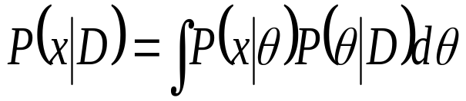
Bayesian parameter estimation
ML approach: θ has a fixed, but unknown value
Bayesian method: θ is a stochastic variable with its own distribution – this distribution expresses our uncertainty about the actual value of θ
    We assume that we know the prior distribution P(θ)
    Using the D training samples, we are looking for P(θ | D), the posterior distribution of θ
  As the final goal, we want to estimate P(x | D). This will be obtained as
    That is, instead of having a point estimate, we marginalize over the possible values of the unknown parameter θ
    In the classifier, we use the above estimate for p(x|c_{i})

Slide 18
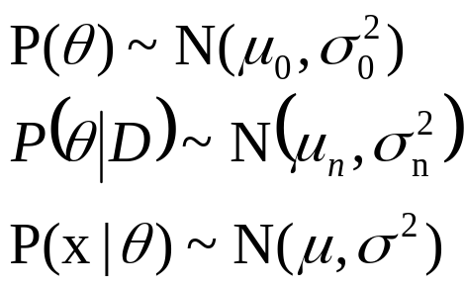
Bayesian parameter estimation 2
As earlier we assume that all the distributions have a Gaussian shape, and only their parameters are unknown
Notations:
Example: univariate case (so we need μ and σ² )
  σ² is known, we have to estimate only μ
  So P(θ | D)= P(μ | D)
a priori distribution of θ (it is known!)
Posterior distribution of θ, estimated from n data samples
The distribution of x for a given θ value

Slide 19
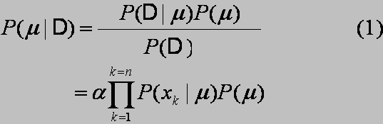
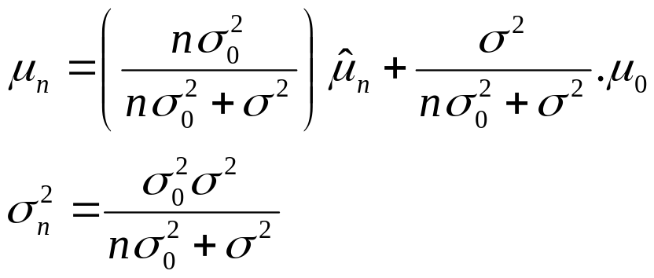

Example
First:
  (as the denominator is independent of μ)
And we assumed that this distribution the shape of :
After tedious derivation we get that
(where is the mean of the samples)

Slide 20

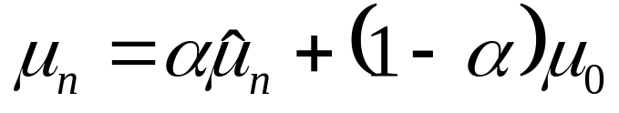

Discussion
μ_{n} is a weighted average of and μ₀
  If the sample size n grows, α goes to one, 1-α to zero
  So we rely more on the estimation based on the data, and rely less on the a priori knowledge
The variance of the estimate gets smaller as the sample size n increases:

Slide 21
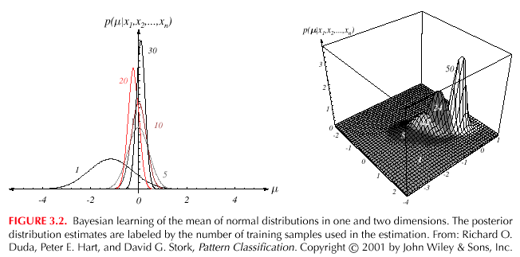
Illustration
(the numbers correspond to n)
With the increase of n the mean converges to a fixed value
The variance gets smaller and smaller, representing that our uncertainty about the actual value decreases

Slide 22
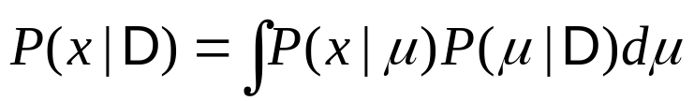
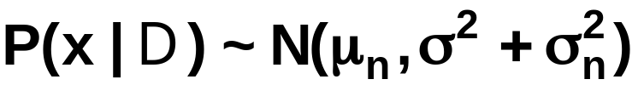

Obtaining P(x | D)
Now we have P(μ | D), but we need P(x | D)
It can be derived that P(x | D) is a normal distribution with parameters
  That is, the Bayesian estimate for the expectation will be μ_{n}
  while for the variance we get σ_{n}+σ, where σ is known, and σ_{n}, expresses the models uncertainty about the estimate (but its converges to zero as n goes to infinity…)
In the multivariate case we would obtain very similar results:
For large n it converges to the same estimates as ML optimization!

Slide 23
Bayesian method, general case
  It can give an estimate for P(x | D) in all cases when we assume some parametric form about the distribution
  Assumptions:
    The shape of P(x | θ) is known, we seek the exact value of θ
    We have some a priori knowledge about θ, represented as P(θ)
    We remaining knowledge about θ is represented as
    n training samples D={ x₁, x₂, …, x_{n} } from P(x)
  The solution will consist of two steps:
  We derive P(θ | D)
  Then we derive P(x | D)

Slide 24

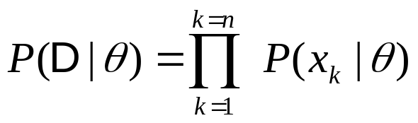
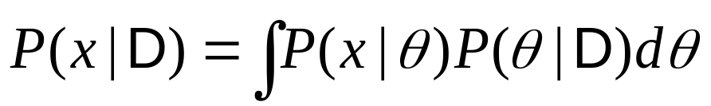
Bayesian method, general case 2
  For the first step we need the independenc assumption and Bayes’ formula:
  For the second step we have to calculate
      In the general case it is not easy to compute formally, in that cases we approximate it numerically (e.g. Gibbs algorithm), or simply by taking its maximum

